Slide 1


Agglomerative Clustering

Slide 2

Our Team
Jevin Kotak
Vinit Kshtriya
Manish Makwana
Aditya Rajput
Mahin Sojitra

Slide 3

What is Agglomerative Clustering ?
Agglomerative clustering is one of methods of clustering data. Opposed to K-Means, Agglomerative clustering supposes that all observations (data points) are clusters and then tries to merge them together to get the desired number of clusters.
The Agglomerative clustering is the most common type of hierarchical clustering used to group objects in clusters based on their similarity.
It uses a bottom-up approach. It starts with each object forming its own cluster and then iteratively merges the clusters according to their similarity to form large clusters. It terminates either
When a certain clustering condition imposed by the user is achieved or
All clustering merge into a single cluster
Notes:
Notes to presenter:
What did you think at first?
What obstacles did you encounter along the way?
How did you overcome those obstacles?
What images can you add to support your process?
This SmartArt allows you add images and text to help outline your process. If a picture is worth a thousand words, then pictures and words should help you communicate this reflection on learning perfectly! You can always click on Insert>SmartArt to change this graphic or select the graphic and click on the Design contextual menu to change the colors.
Feel free to use more than one slide to reflect upon your process. It also helps to add some video of your process.

Slide 4
What is Agglomerative Clustering ?
The algorithm starts by treating each object as a singleton cluster.
Next, pairs of clusters are successively merged until all clusters have been merged into one big cluster containing all objects.
The result is a tree-based representation of the objects, named Dendrogram.
Each object is initially considered as a single-element cluster(leaf).
At each step of the algorithm, the two clusters that are the most similar are combined into a new bigger cluster(nodes). This procedure is iterated until all points are member of just one single big cluster (root) .
The inverse of agglomerative clustering is divisive clustering. It is works in a “top-down” manner. It begins with the root , in which all objects are included in a single cluster.
Notes:
Notes to presenter:
What did you think at first?
What obstacles did you encounter along the way?
How did you overcome those obstacles?
What images can you add to support your process?
This SmartArt allows you add images and text to help outline your process. If a picture is worth a thousand words, then pictures and words should help you communicate this reflection on learning perfectly! You can always click on Insert>SmartArt to change this graphic or select the graphic and click on the Design contextual menu to change the colors.
Feel free to use more than one slide to reflect upon your process. It also helps to add some video of your process.

Slide 5
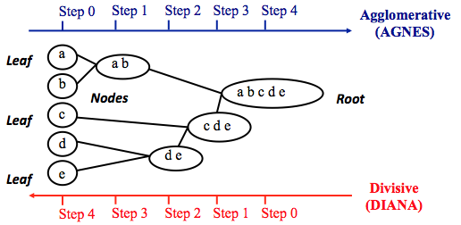
Notes:
Notes to presenter:
What was important about this learning experience?
How is it relevant to your course, yourself, or your society or community?
Why is this significant?
This SmartArt allows you add images and text to help outline your process. If a picture is worth a thousand words, then pictures and words should help you communicate this reflection on learning perfectly! You can always click on Insert>SmartArt to change this graphic or select the graphic and click on the Design contextual menu to change the colors.

Slide 6
PROS and CONS
No need for information about how many numbers of clusters are required.
Easy to use and implement.
It can be used with different types of data such as numerical, categorical and binary.
It can be used for datasets of any size.
Capable of producing clusters with non-convex shapes.
We cannot take a step back in this algorithm.
Time complexity is higher at least 0(n^2logn).
May not produce same results each time.
Not suitable for High-dimensional data.
No guarantee that the resulting clusters in agglomerative clustering are meaningful.

Slide 7

Steps to agglomerative clustering
Compute the proximity matrix using a distance metric.
Use a linkage function to group into hierarchical cluster tree based on the computed distance matrix from the above step.
Data points with close proximity are merged together to form a cluster.
Repeat steps 2 and 3 until a single cluster remains.
Notes:
Notes to presenter:
What steps will you be taking as a result of this learning experience?
Did you learn from any failed experiences? How will you do things differently?
What advice will you give to others so they can learn from your experiences?
How can you share what you learned with a real-world audience?
Some examples of next steps might be:
After delivering my first persuasive presentation, I am thinking about joining the debate team.
After making my first film, I’m considering entering it in our school film festival or local film festival.
After connecting with this career expert, I’d like to do some research on that career field because it sounds interesting to me.
This SmartArt allows you add images and text to help outline your process. If a picture is worth a thousand words, then pictures and words should help you communicate this reflection on learning perfectly! You can always click on Insert>SmartArt to change this graphic or select the graphic and click on the Design contextual menu to change the colors.
Feel free to use more than one slide to share your next steps. It also helps to add some video content to explain your message.

Slide 8
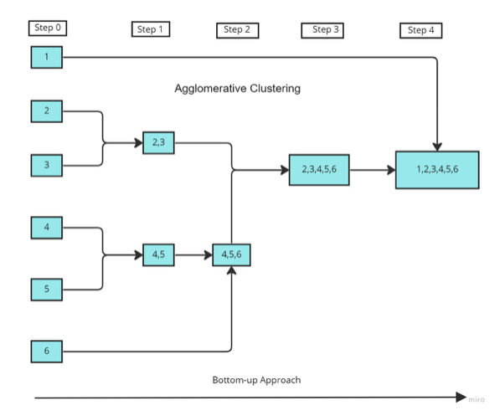

Slide 9
Steps of the figure
The data points 1,2,3,4,5,6 are assigned to each individual cluster.
After calculating the proximity matrix, based on the similarity the points (2,3) and (4,5) are merged together to form clusters.
Again, the proximity matrix is computed and clusters with points (4,5) and 6 are merged together.
And again, the proximity matrix is computed, then the clusters with points (4,5,6) and (2,3) are merged together to form a cluster.
As a final step, the remaining clusters are merged together to form a single cluster.

Slide 10
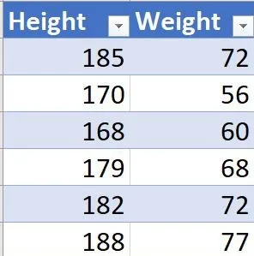
Example
Step 1 : Make each data point as a single-point cluster.
Step 2: Take the two closest distance clusters by single linkage method and make them one clusters.
Before using single linkage method on each clusters, we must know the distance between clusters.
Let’s visualize the distance between each clusters with the help of distance matrix. Here, I am taking Euclidean distance between two points.

Slide 11
Example
P00 = 0, P11 = 0, P22 = 0, P33 = 0, P44 = 0
(this is because distance between self is 0)
Distance between two points P12
= sqrt((P1.X – P2.x)^2 + (P1.Y – P2.Y)^2)
= sqrt((170-168)^2 + (56-60)^2)
= sqrt(4+16)
= sqrt(20)
= 4.47

Slide 12
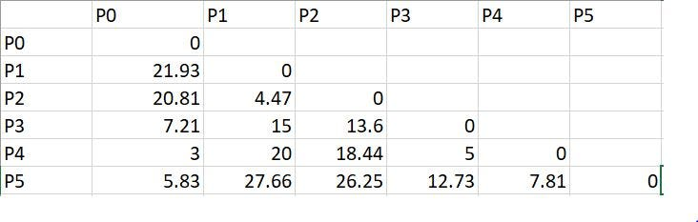
Distance Matrix of all points

Slide 13
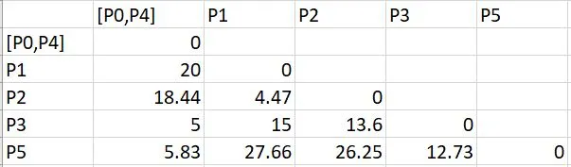
Example
Now we have to see which cluster has minimum distance And the distance we found first is P0 and P4 which is 3.So, we must group these two clusters together.Now with the help of single linkage method we will merge two clusters.

Slide 14
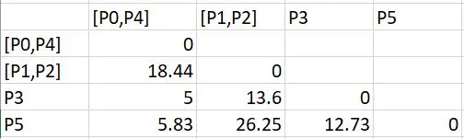
Example
Step 3 : Repeat step 2
Again the minimum distance is P1-P2. So, the next distance matrix will be:
After Merging of P1 and P2

Slide 15
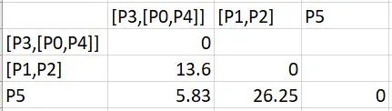
Example
Step 3: Repeat step 2
Now minimu distance is P3-[P0,P4] which is 5. So, the next distance matrix will be:
After Merging of P3 and [P0,P4]

Slide 16

Example
Step 3: Repeat step 2
Now minimum distance is P5-[P3,[P0,P4]] which is 5.83. So, the next distance matrix will be:
After merging of P5 and [P3,[P0,P4]]

Slide 17

Example
Step 3: Repeat step 2
Now there are only two clusters whose distance is 13.6. So, the final distance matrix will be:
After Merging of [P1,P2] and [P5,[P3,[P0,P4]]]

Slide 18
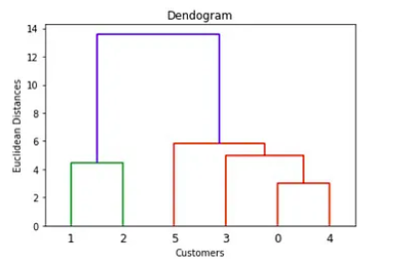
Example
Step 4: Ceate a dendrogram to visualize the history of grouping.

Slide 19
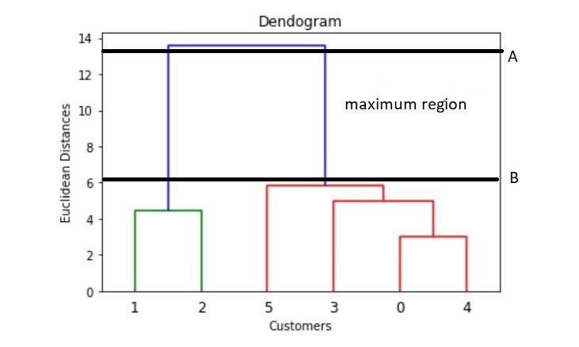
Example
Step 5: Find optimal number of cluster from dendrogram.

Slide 20
Example
For finding the optimal number of clusters we need to:
Determine the largest vertical distance that doesn’t intersect any other cluster.
Draw two horizontal lines at both extremes like A and B.
The optimal number of cluster = number of vertical lines going through the horizontal lines.
From Dendrogram we can clearly see that there are 2 vertical lines through horizontal lines.
Therefore, Optimal number of clusters = 2.

Slide 21
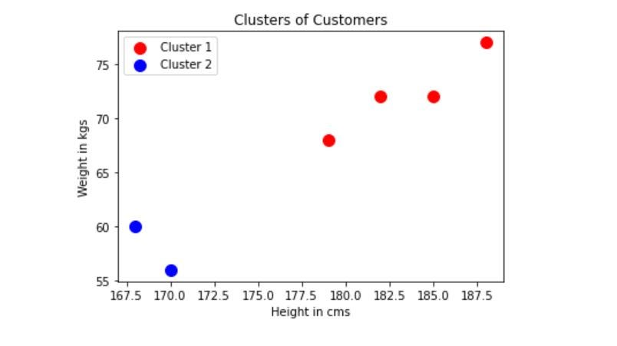
Visualizing the final clusters

Slide 22
Thank you

